Slide 1
HR Analytics Presentation

Slide 2
Why do we need Employee Retention in an organization?
Employee retention is crucial for organizations as it leads to cost savings, knowledge retention, higher productivity, improved employee morale, better customer experience, a stable company culture, increased engagement and innovation, and enhanced revenue and ROI. By focusing on retaining employees, organizations can create a more stable, productive, and positive work environment, leading to better overall business outcomes.

Slide 3






Project analysis slide 2
Objective Analytics
Average Attrition rate for all Departments
Average working years for each Department
Employee Retention
Average Hourly rate of Male
Research Scientist
Job Role Vs Work life balance
Attrition rate Vs Monthly
income stats
Attrition rate Vs since last Year promotion relation

Slide 4






Project analysis slide 3
Distribution of field
Average Attrition rate for all Departments
Average Hourly rate of Male
Research Scientist
Attrition rate Vs Monthly
income stats
Average working years for each Department
Job Role Vs Work life balance
Attrition rate Vs since last Year promotion
The Research & Development department has the highest attrition rate at 51.21%, compared to other departments
The average hourly rate for male research scientists is 114.447, which is lower than the 115.927 for female research scientists
Sales has the highest total monthly income at $22.07M, while Research & Development has the highest attrition rate at 51.21%..
The Human Resources, Sales, and Software departments have the same average working years compared to other departments
Employees in the healthcare department are the most satisfied with their job roles compared to other departments.
Across all 40 years of rate ranges since the last promotion, attrition ranges from 0.00% to 77.78%

Slide 5
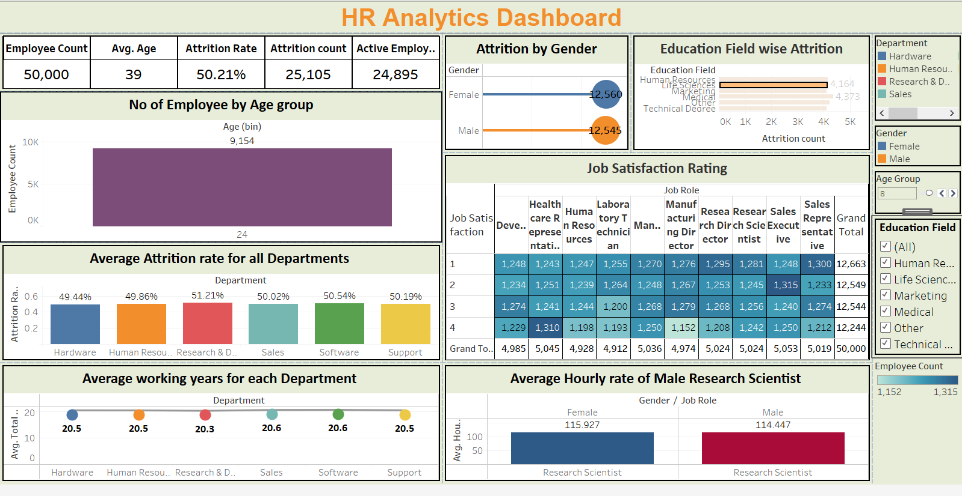

Slide 6
Project analysis slide 6
Recommendation
The research & development department has the highest attrition rate. To retain these employees, we should restructure their salaries according to market standards and consider promoting them to appreciate their hard work.
Employees working more hours than average should be awarded cash prizes to encourage extra hours.
The Tableau dashboard shows an average tenure of 20 years across departments, indicating a good reputation but also high attrition, suggesting HR management issues. Data reveals over 25% of healthcare employees report excellent job satisfaction, while sales employees report poor satisfaction.
To improve job satisfaction, personal interviews should be conducted to address issues and find productive solutions.

Slide 7

Project analysis slide 6
Team Credits
Mrs. Priti Siddharth Waghmare
Mrs. Priti Siddharth Waghmare
Ms. Bungatavula Madhu Priya
Ms. Rutuja Nikhil Doiphode
Ms. Suman Panigrahi
Mr. Abhishek Dhumal

Slide 8
Thank You

